Slide 1
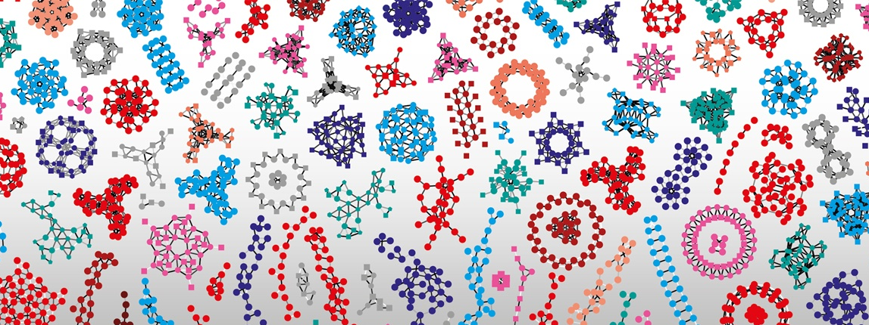


Fun with RDF
Vital-IT internal group meeting
5th of April 2022
Marco Pagni

Slide 2
Part 1 Basic concepts in RDF First step with GraphDB

Slide 3
IRI - Internationalized Resource Identifier
Example:
https://www.sinergiawolfender.org/jlw/VGF144_G10
https://en.wiktionary.org/wiki/Ῥόδος
rewritten as URI
https://en.wiktionary.org/wiki/%E1%BF%AC%CF%8C%CE%B4%CE%BF%CF%82
URN:ISBN:0-395-36341-1
Remark:
IRI is a superset of URI (IRI ⊃ URI)
URI is a superset of URL (URI ⊃ URL)
URI is a superset of URN (URI ⊃ URN)
URL and URN are disjoint (URL ∩ URN = ∅)
An IRI is used to uniquely identify a RDF resource
A resource can be almost anything:
a color
a plant species
a web site
…
Notes:
RI, URI, URL, URN and their differences
Everybody dealing with the Semantic Web repeatedly comes across the terms IRI, URI, URL and URN. Nevertheless, I frequently observe that there is some confusion about their exact meaning. And, of course, others noticed that as well (see e.g. [RFC3305] or search on Google). To be honest, I even was confused myself at the outset. But actually the issue is not that complex. Let’s have a look on the definitions of the mentioned terms to see what the differences are:
URIA Uniform Resource Identifier is a compact sequence of characters that identifies an abstract or physical resource. The set of characters is limited to US-ASCII excluding some reserved characters. Characters outside the set of allowed characters can be represented using Percent-Encoding. A URI can be used as a locator, a name, or both. If a URI is a locator, it describes a resource’s primary access mechanism. If a URI is a name, it identifies a resource by giving it a unique name. The exact specifications of syntax and semantics of a URI depend on the used Scheme that is defined by the characters before the first colon. [RFC3986]URNA Uniform Resource Name is a URI in the scheme urn intended to serve as persistent, location-independent, resource identifier. Historically, the term also referred to any URI. [RFC3986] A URN consists of a Namespace Identifier (NID) and a Namespace Specific String (NSS): urn:<NID>:<NSS> The syntax and semantics of the NSS is specific specific for each NID. Beside the registered NIDs, there exist several more NIDs, that did not go through the official registration process. [RFC2141]URLA Uniform Resource Locator is a URI that, in addition to identifying a resource, provides a means of locating the resource by describing its primary access mechanism [RFC3986]. As there is no exact definition of URL by means of a set of Schemes, URL is a useful but informal concept, usually referring to a subset of URIs that do not contain URNs [RFC3305].IRIAn Internationalized Resource Identifier is defined similarly to a URI, but the character set is extended to the Universal Coded Character Set. Therefore, it can contain any Latin and non Latin characters except the reserved characters. Instead of extending the definition of URI, the term IRI was introduced to allow for a clear distinction and avoid incompatibilities. IRIs are meant to replace URIs in identifying resources in situations where the Universal Coded Character Set is supported. By definition, every URI is an IRI. Furthermore, there is a defined surjective mapping of IRIs to URIs: Every IRI can be mapped to exactly one URI, but different IRIs might map to the same URI. Therefore, the conversion back from a URI to an IRI may not produce the original IRI. [RFC3987]Summarizing we can say:
IRI is a superset of URI (IRI ⊃ URI)
URI is a superset of URL (URI ⊃ URL)
URI is a superset of URN (URI ⊃ URN)
URL and URN are disjoint (URL ∩ URN = ∅)
Conclusions for Semantic Web Issues
RDF explicitly allows to use IRIs to name entities [RFC3987]. This means that we can use almost every character in entity names. On the other hand, we often have to deal with early state software. Thus, it is not unlikely to run into problems using non ASCII characters. Therefore, I suggest to avoid non URI names for entities and recommend to use http URIs [LINKED-DATA]. To put it briefly: only use URLs to name your entities. Of course, we can refer to existing entities named by a URN. However, we should avoid to newly create this kind of identifiers.
References
[LINKED-DATA]T. Berners-Lee. Linked Data – Design issues. 27 July 2006. URL: https://www.w3.org/DesignIssues/LinkedData.html[RDF11-CONCEPTS]Richard Cyganiak, David Wood, Markus Lanthaler. RDF 1.1 Concepts and Abstract Syntax. W3C Recommendation, 25 February 2014. URL: http://www.w3.org/TR/2014/REC-rdf11-concepts-20140225/. The latest edition is available at http://www.w3.org/TR/rdf11-concepts/[RFC2141]R. Moats. URN Syntax. May 1997. RFC. URL: http://www.ietf.org/rfc/rfc2141.txt[RFC3305]M. Mealling; R. Denenberg. Report from the Joint W3C/IETF URI Planning Interest Group: Uniform Resource Identifiers (URIs), URLs, and Uniform Resource Names (URNs): Clarifications and Recommendations. August 2002. RFC. URL: http://www.ietf.org/rfc/rfc3305.txt[RFC3986]T. Berners-Lee; R. Fielding; L. Masinter. Uniform Resource Identifier (URI): Generic Syntax. January 2005. RFC. URL: http://www.ietf.org/rfc/rfc3986.txt[RFC3987]M. Dürst; M. Suignard. Internationalized Resource Identifiers (IRIs). January 2005. RFC. URL: http://www.ietf.org/rfc/rfc3987.txtBY JAN MARTIN KEIL IN BLOG ON NOVEMBER 18, 2016

Slide 4
Long and short forms of IRIs
The long form of IRI (Turtle syntax):
<https://www.sinergiawolfender.org/jlw/VGF144_G10>
The short form (Turtle syntax)
@prefix jlw: <https://www.sinergiawolfender.org/jlw/> .
jlw:VGF144_G10
Nota bene:
The long form is the reference one.
Short form is more human friendly.
But the prefix declaration is local (i.e. not internationally defined).
Different short form identifiers may actually refer to the same long form identifier.

Slide 5
PREFIXES and vocabularies
short | long | comment
rdf: | http://www.w3.org/1999/02/22-rdf-syntax-ns# | These are ubiquitous prefixes in the RDF world. They are understood and interpreted properly by most RDF software
rdfs: | http://www.w3.org/2000/01/rdf-schema#
skos: | http://www.w3.org/2004/02/skos/core#
foaf: | http://xmlns.com/foaf/0.1/
... | ...
short | long | comment
jlw: | https://www.sinergiawolfender.org/jlw/ | These are specific to our project. Retrospectively, one would have been enough.
cw: | https://www.sinergiawolfender.org/cw/
ts: | https://www.sinergiawolfender.org/ts/
vit: | https://www.sinergiawolfender.org/vit/

Slide 6
RDF Triple
The simplest possible RDF graph is made of a single triple, for example:
<https://www.sinergiawolfender.org/jlw/VGF144_G10> <http://www.w3.org/1999/02/22-rdf-syntax-ns#type> <https://www.sinergiawolfender.org/jlw> .
That can be more conveniently rewritten using short form notation
@prefix jlw: <https://www.sinergiawolfender.org/jlw/> .
@prefix rdf: <http://www.w3.org/1999/02/22-rdf-syntax-ns#> .
jlw:VGF144_G10 rdfs:type jlw:LabExtract
which can be further simplifies in Turtle:
jlw:VGF144_G10 a jlw:LabExtract

Slide 7
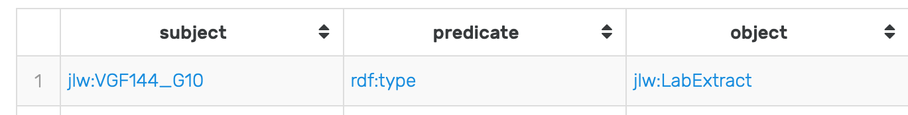

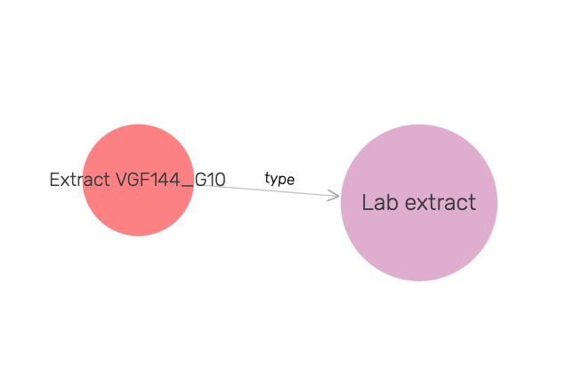
RDF triple
jlw:VGF144_G10 rdf:type jlw:LabExtract
subject
predicate
object

Slide 8

Literal
jlw:VGF144_G10 rdfs:label "Extract VGF144_G10"
subject
predicate
object
Nota Bene:
Literal are only permitted to occur as the object position in a triple
Literal types include: string, integer, double, date, ...

Slide 9
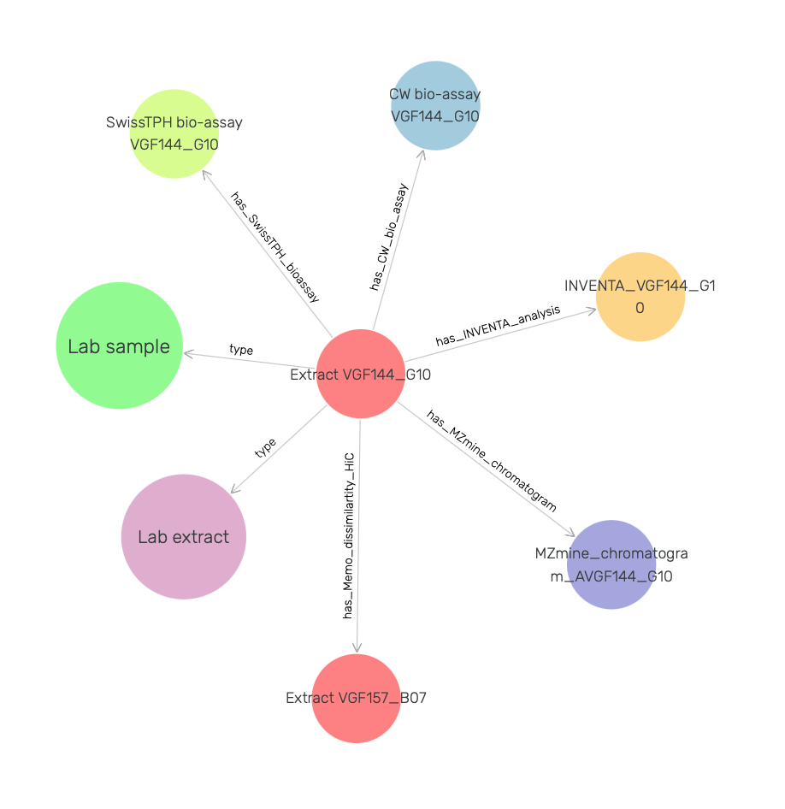
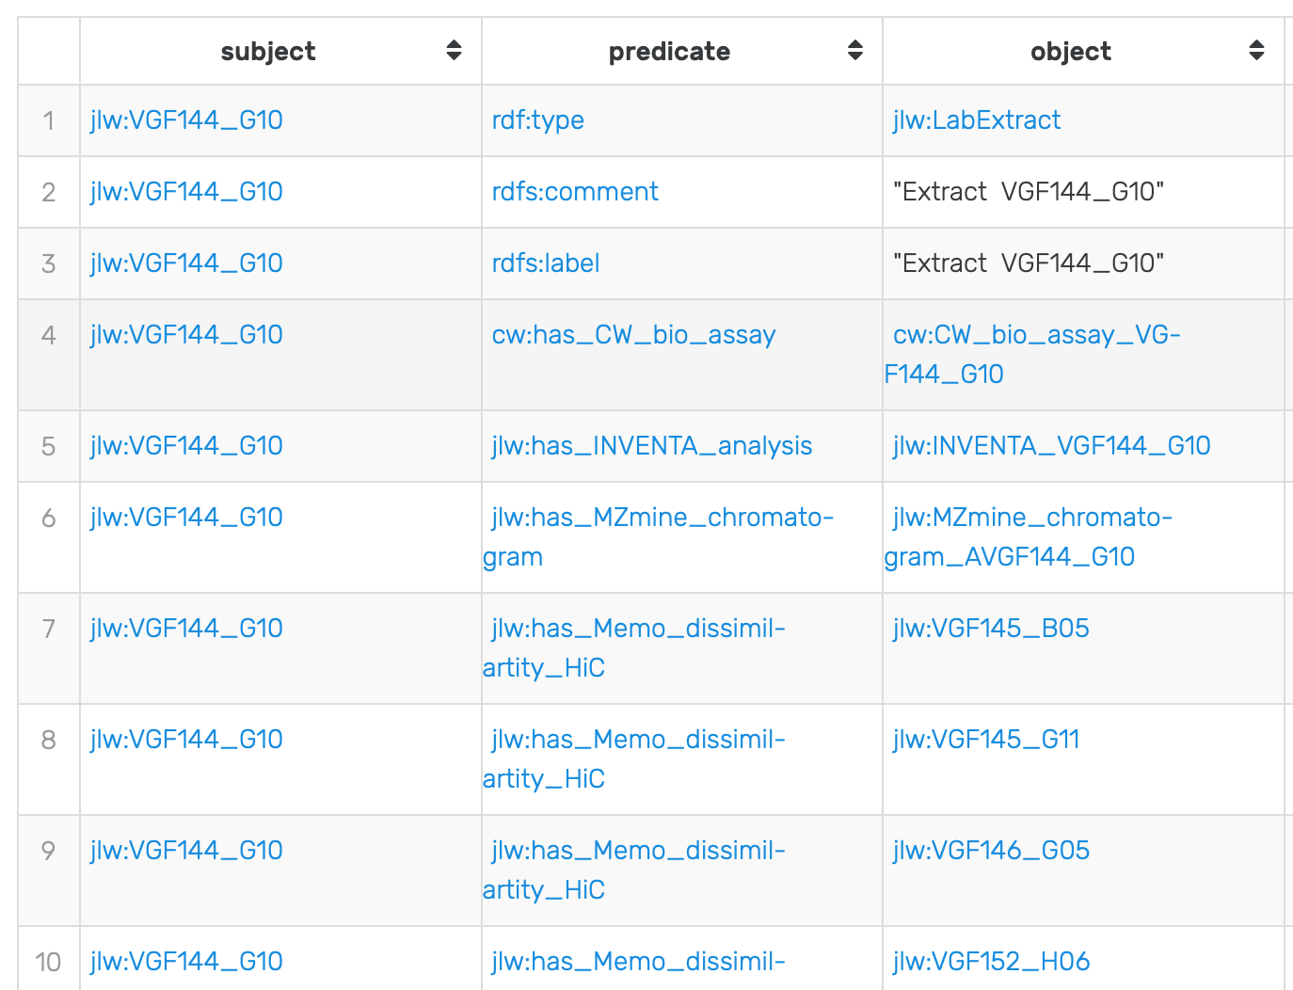
Documenting lab extract "VGF144_G10"
This is a simple star-shaped graph

Slide 10
A few ubiquitous predicates
predicate | object type | comment
rdf:type | class IRI | usually abreviated with 'a' in Turtle every IRI should belong to a class multiple types are permitted
rdfs:label | string literal | should be short should have a unique value
rdfs:comment | string literal | should be more descriptive than label
foaf:depiction | image URL | used by graphdb-workbench to identify images

Slide 11
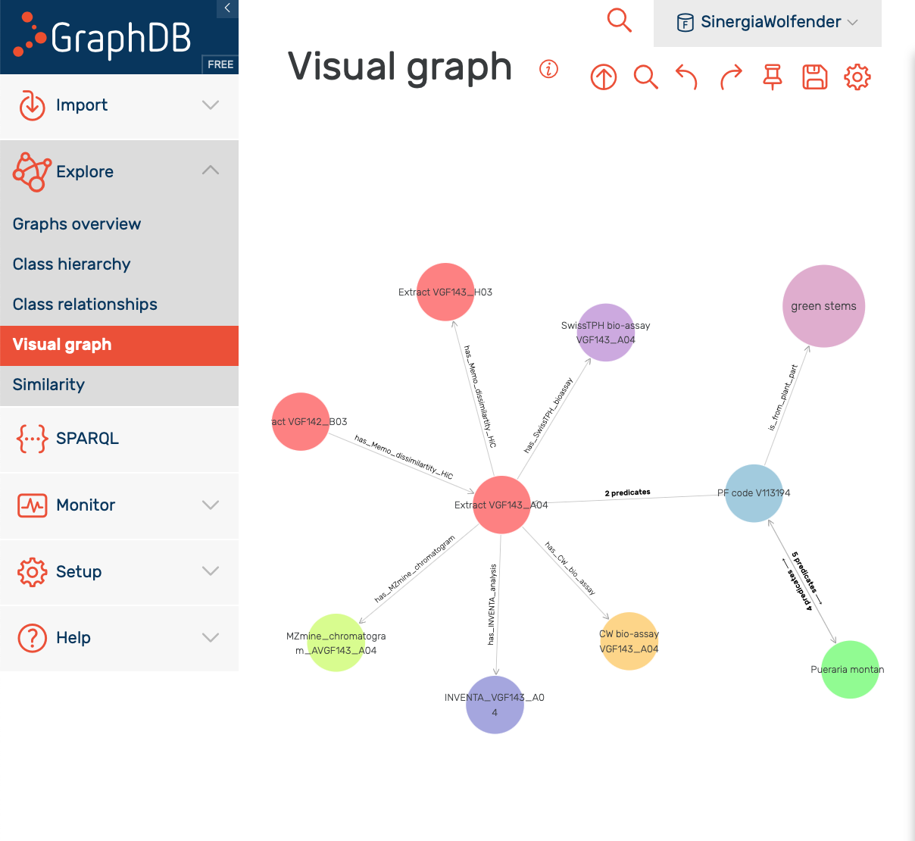

GraphDB – an RDF store and GUI
graphdb-workbench | Web interface (React JS, open source on GitHub)
web server | RDF4J (open source Java AFAIK)
"GraphDB Sail" | Proprietary database engine
setup_graphdb.py
Ia command line tool to deploy a GraphDB instance with the current Sinergia repository
Pros:
GraphDB is easy to install as a standalone application and is running anywhere in any browser
The database engine is very performant on "not too large" dataset
The GUI make it usable by people with little knowledge of RDF and SPARQL
Cons:
The graphdb-workbench is a little buggy and a pain to deal with script-wise.
Visual graphs are hard to parametrize.
GraphDB free edition does not allow more than two simultaneous queries.

Slide 12
Login to https://www.sinergiawolfender.org
Username: sinwolf
Password: sinwolf6789
Nota Bene:
The authentication on the web site relies on a cookie.
The SinergiaWolfender repository within GraphDB is accessible read-only (once logged on https://www.sinergiawolfender.org). There is no need to log in again within GraphDB.
There is a built-in limit of TWO queries that can be runned simulaneously in GraphDB Free. It should not be a problem as long as you avoid launching queries tagged with SLOW during this tutorial.

Slide 13
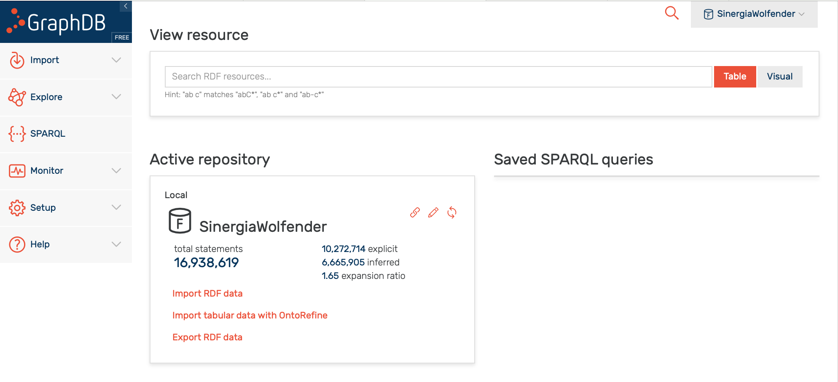
Exercise 1
Question 1: Use the search field to retrieve the IRI of lab extract VGF144_G10

Slide 14
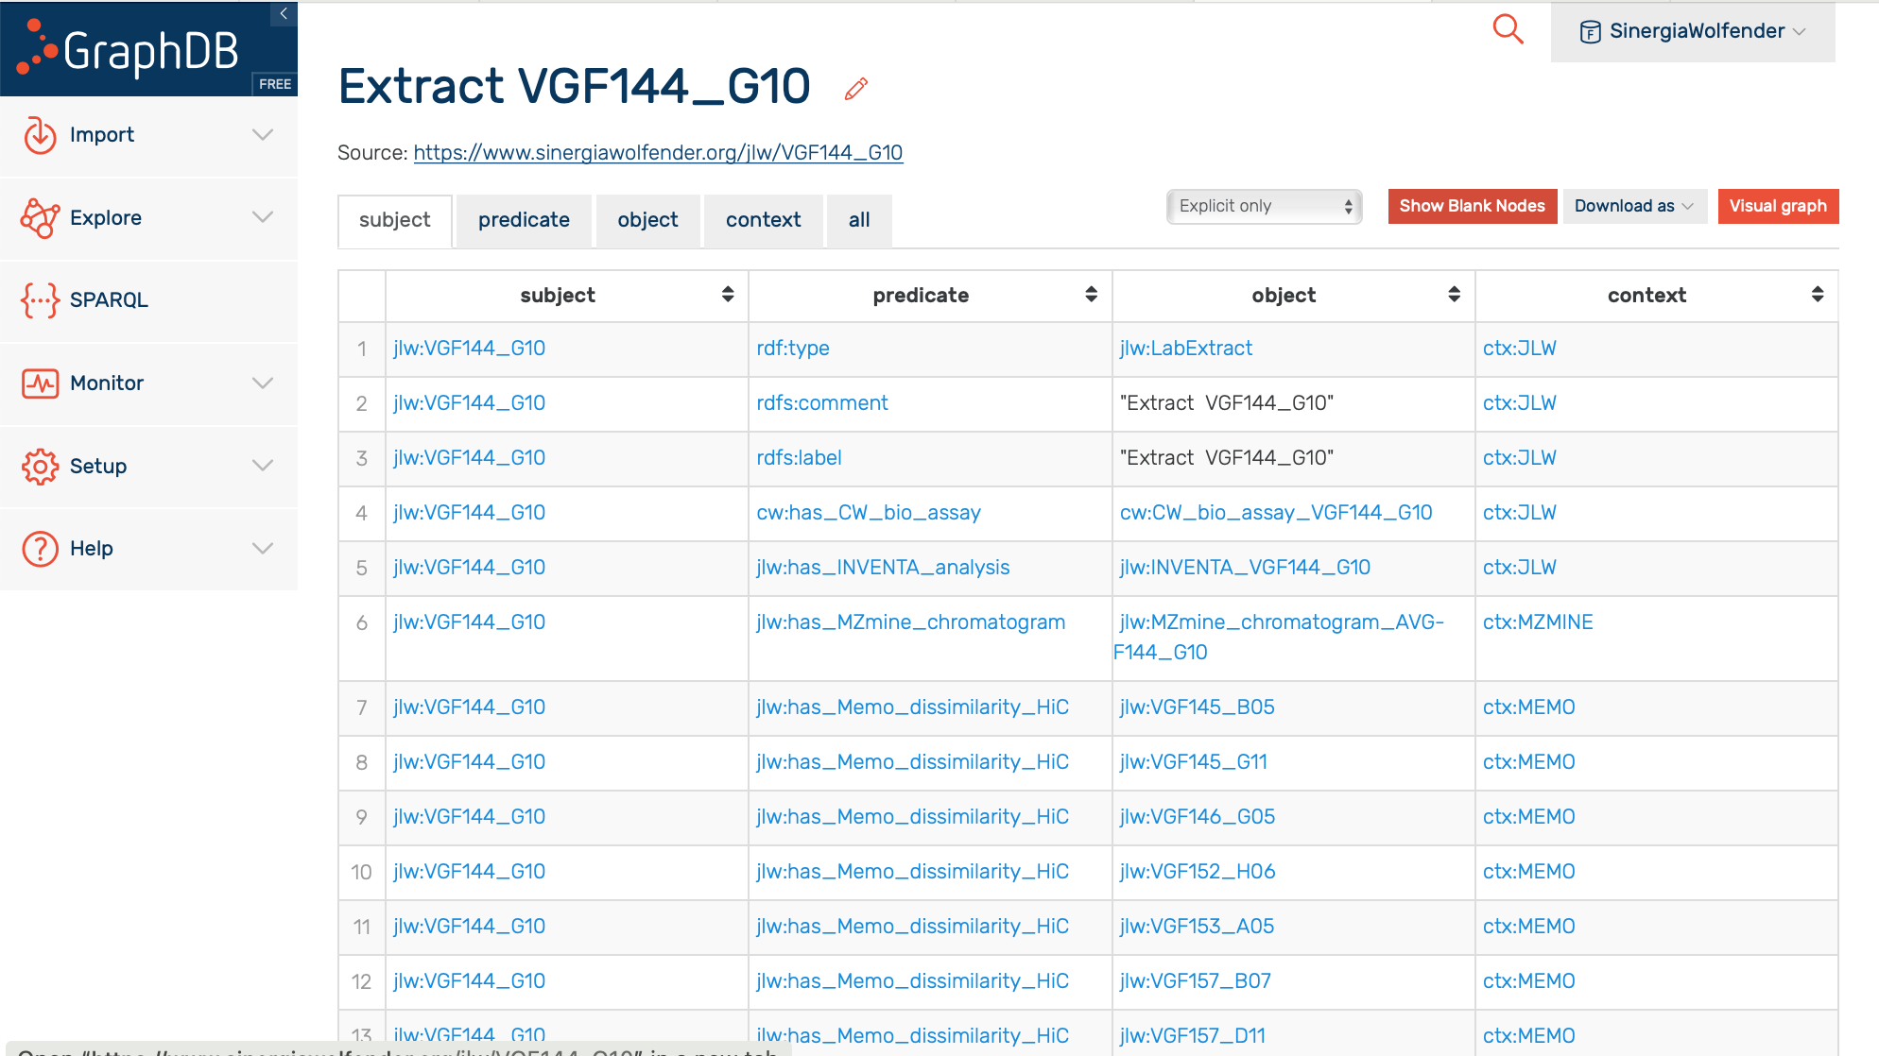
rdfs:label
IRI long form
IRI short form

Slide 15
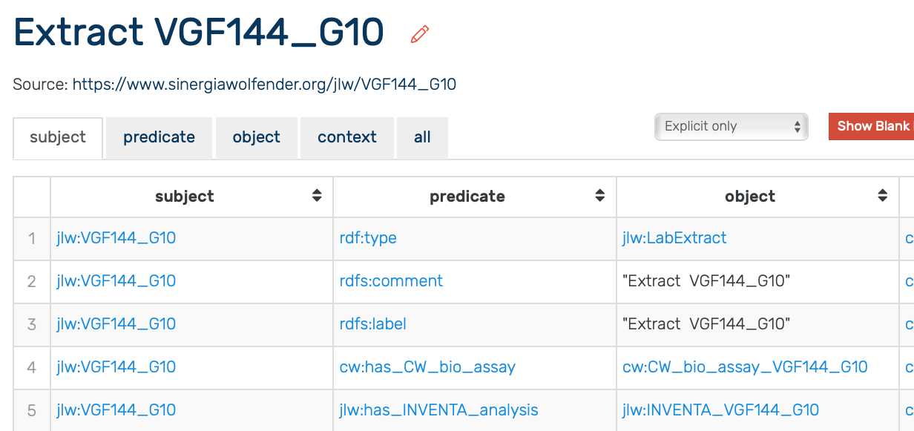
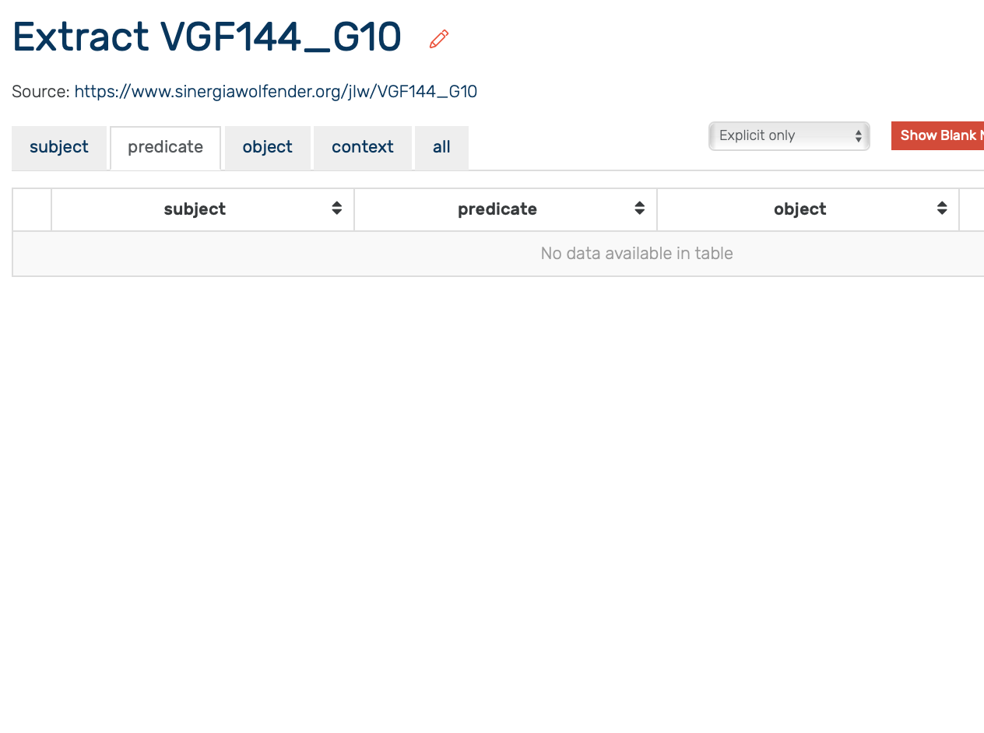
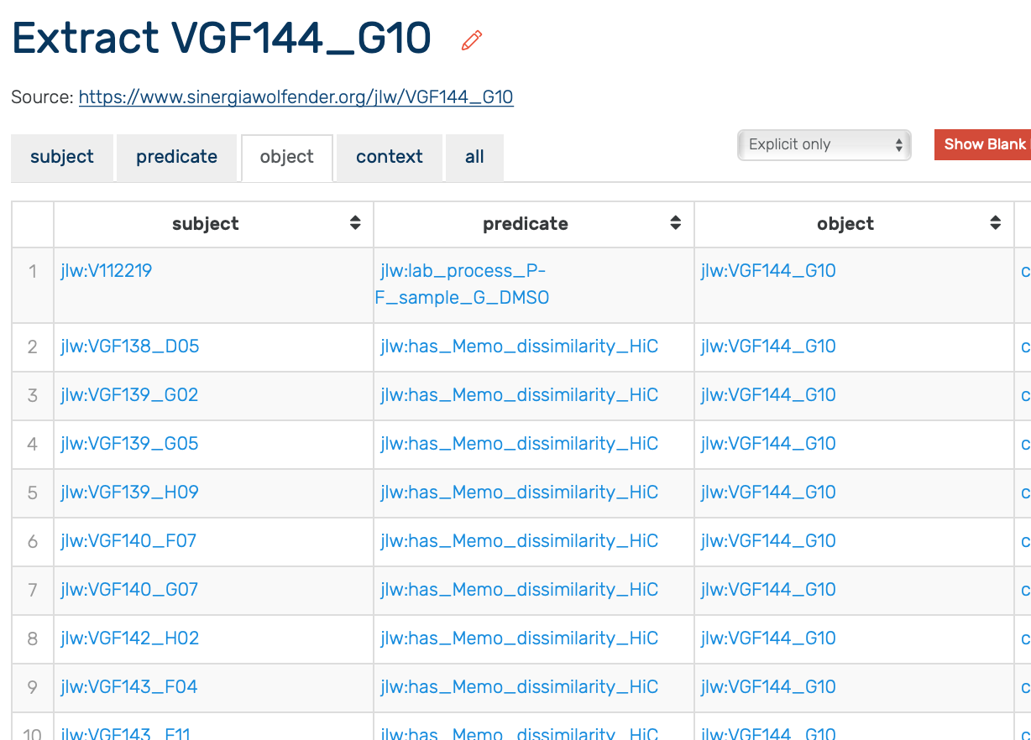
jlw:VGF144_G10
as subject
as predicate
as object

Slide 16
Exercise 1
Using the IRI search box, and the table display, answer the following question:
What is the stock quantity of PF-code V100020
To which plant family belongs the Brillantaisia genus
What is the cytoxicity determined by the TPH for extract VGF144_G10 (you need to crawl more than one table)
Which plant species are available in plant familly Goodeniaceae

Slide 17
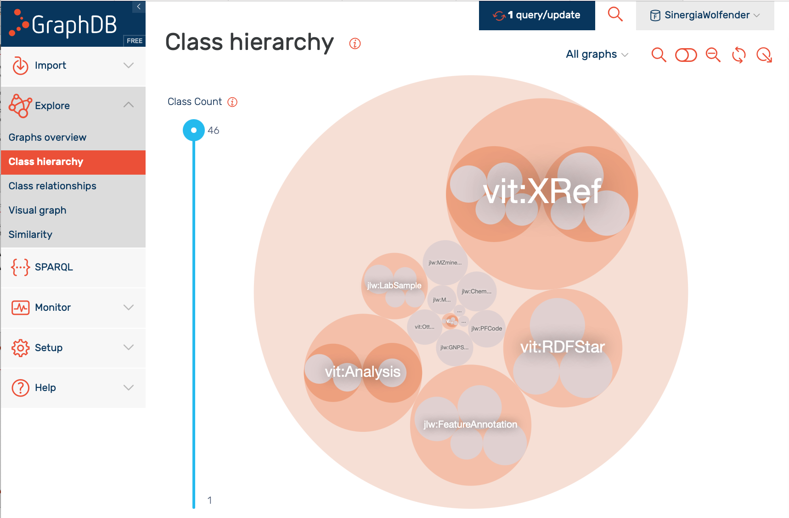
Class hierarchy
Best place to start if you want to understand the structure of the database
Live demo

Slide 18
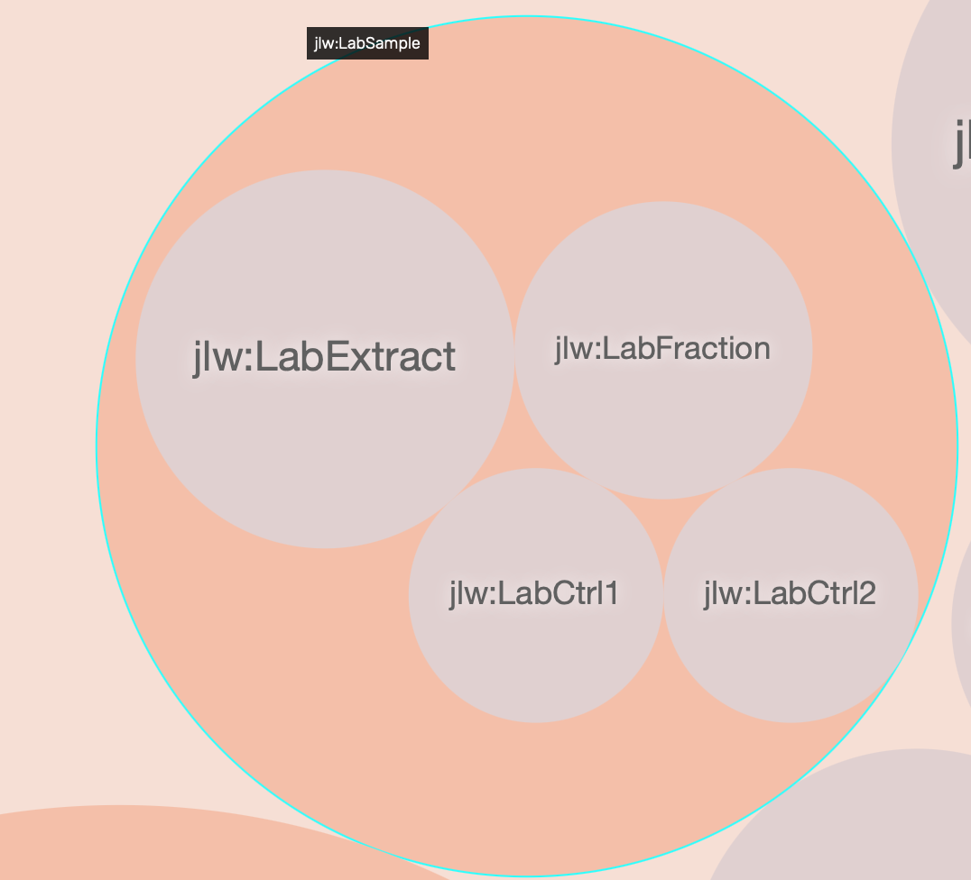
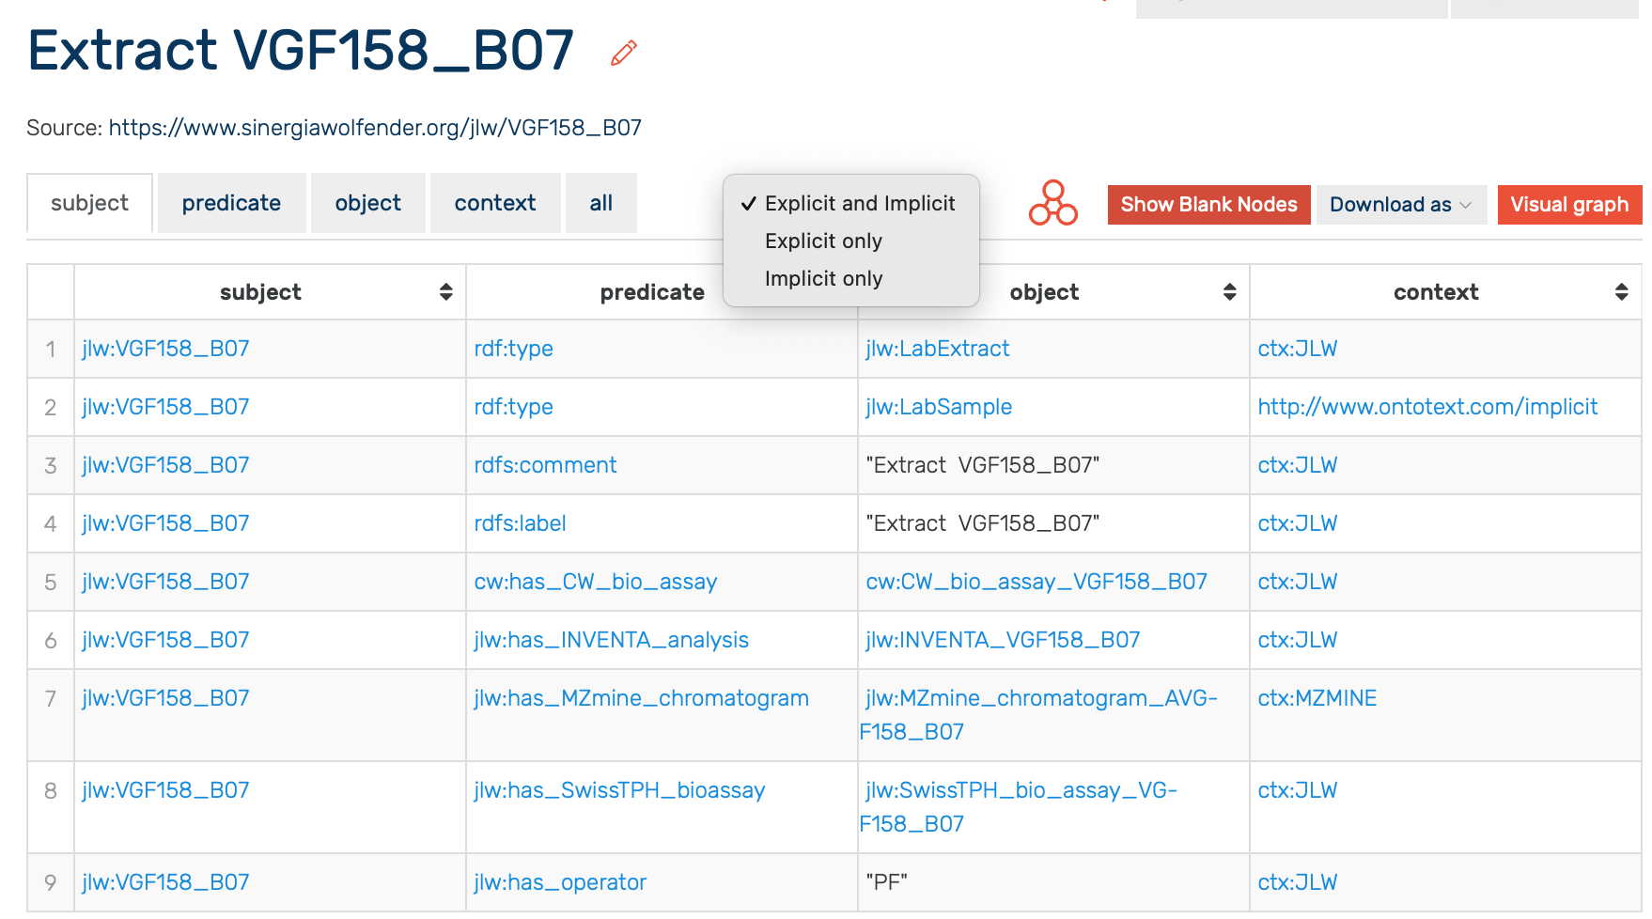
Inference on RDF-schema (the semantic thing)

Slide 20
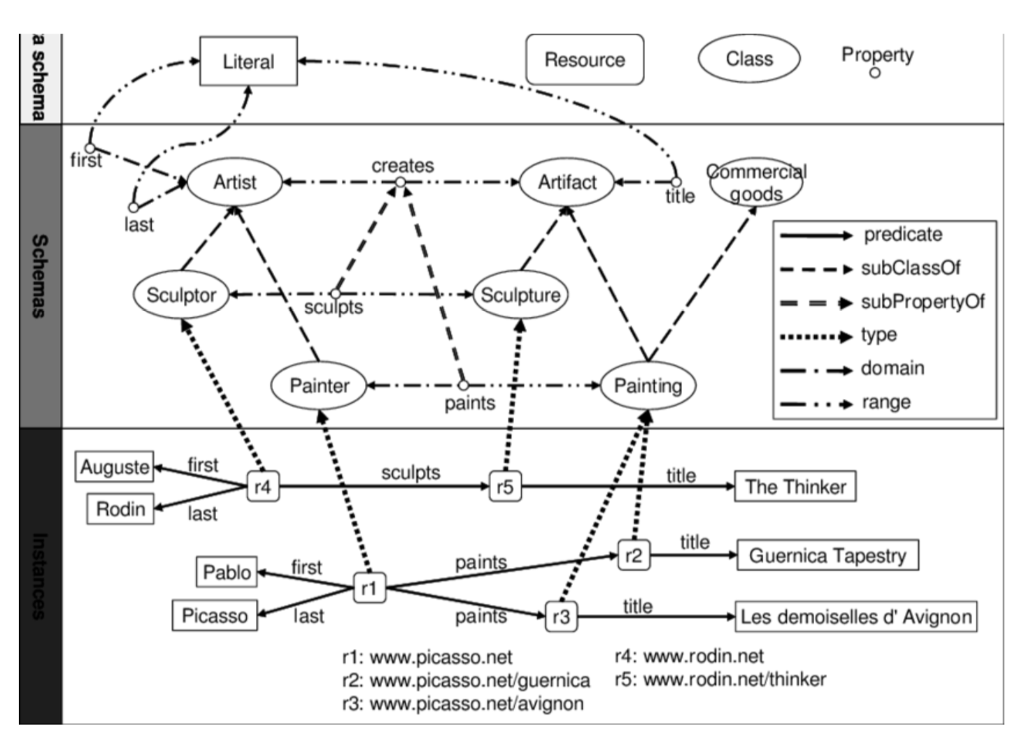
RDFS

Slide 21


Inference on RDF-schema (the semantic thing)
Include inferred data in results: ON/OFF and it can be useful
Expand results over owl:sameAs: It has no effect in our repository!

Slide 22
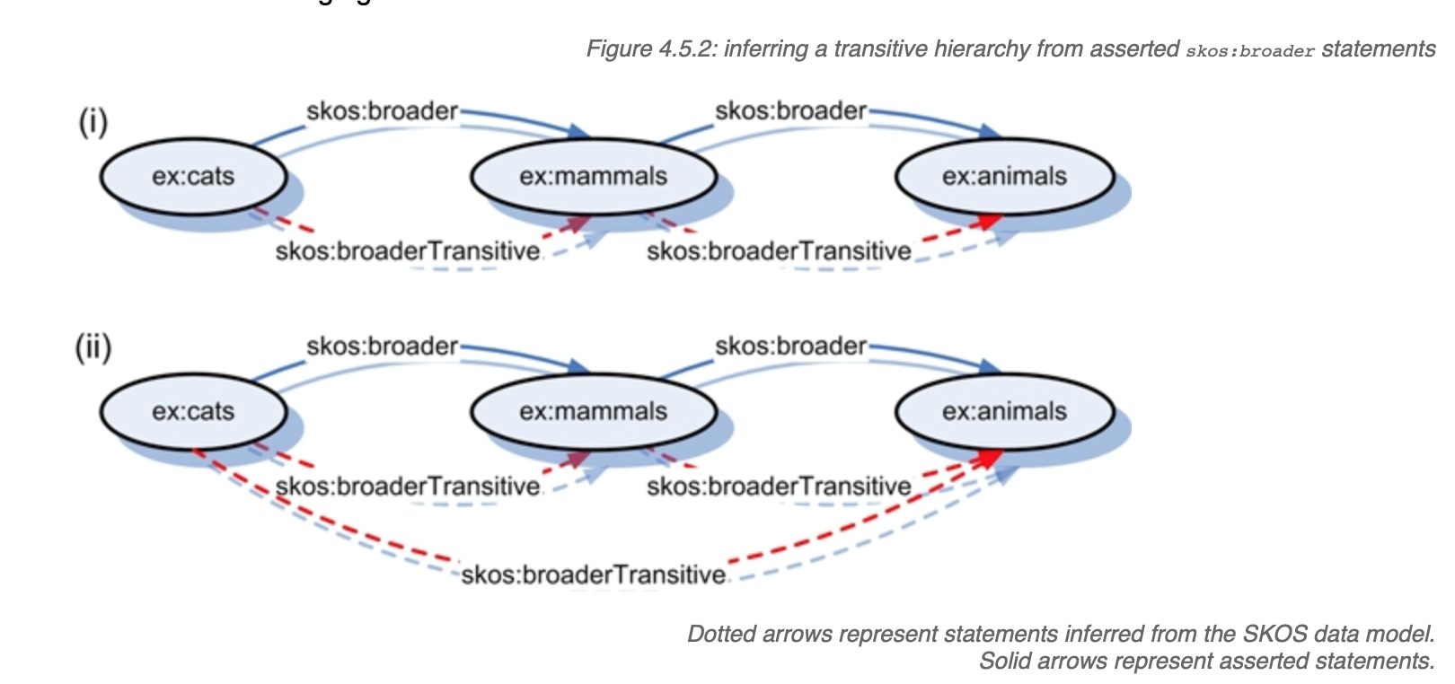
A little bit of semantics
SKOS: Simple Knowledge Organization System
It should be considered it as an optional "organizational" layer on top of the RDF graph.
It has the great advantages of being small, stable and relatively simple. It is mainly used in digital humanities.
It is sound for modelling relations between entities, like cross-references.

Slide 23
The gory details

Slide 24
Naming convention
The distinction between a class and an instance of a class is enforced. It is more simple like this, at least for me.
Class names are written using camel case
Instance and property names ar written using snake case
Acronyms are always written as their are (most often in uppercase)

Slide 25
Our predicate syntax
predicate | object type | comment
jlw:has_* jlw:is_ cw:has_* ts:has_* vit:has_* | IRI or literal | predicate name should be sufficiently descriptive
jlw:lab_proccess_ | IRI | specific for sample processing
vit:*_xref | IRI | identifes a resource in an external database

Slide 26
Visual graphs
This is a great educational to!
GraphDB is providing a one-size-fits-all implementation with several limitations:
Limited number of nodes displayed
Hard choice between arrows and properties
Hard-coded default configuration
User-based configuration not available in read-only mode
A version 2 of graphdb-workbench is in preparation
I am investigating alternative solution for visualizing graphs

Slide 27
Redo
Redo exercise 1 using the Visual graph interface
What is the stock quantity of PF-code V100020
To which plant family belongs the Brillantaisia genus
What is the cytoxicity determined by the TPH for extract VGF144_G10 (you need to crawl more than one table)
Which plant species are available in plant familly Goodeniaceae

Slide 28
Graph queries
The graph to search | Query | Solution
?
?
?
?
?
empty

Slide 29
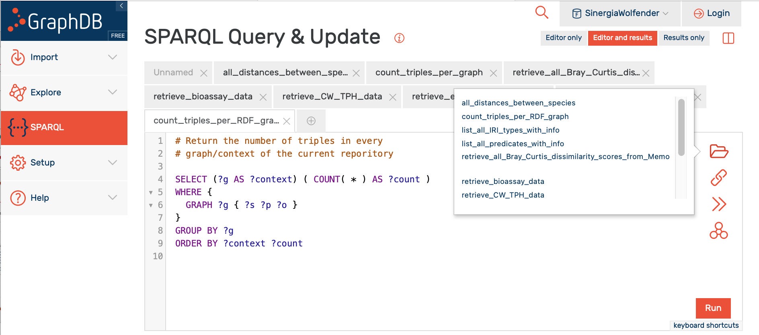
SPARQL is a language to formulate graph queries
You don’t need to understand SPARQL to utilize SPARQL

Slide 30
Exercise time
Try to run a few SPARQL queries
Please DO NOT RUN (now) queries tagged with SLOW because of the two queries limit of GrapDB

Slide 31
The result of a SPARQL SELECT query is a table with multiple columns
The result of a SPARQL CONSTRUCT query is a graph, i.e. a table of triples
The result of a SPARQL ASK query is true or false

Slide 32

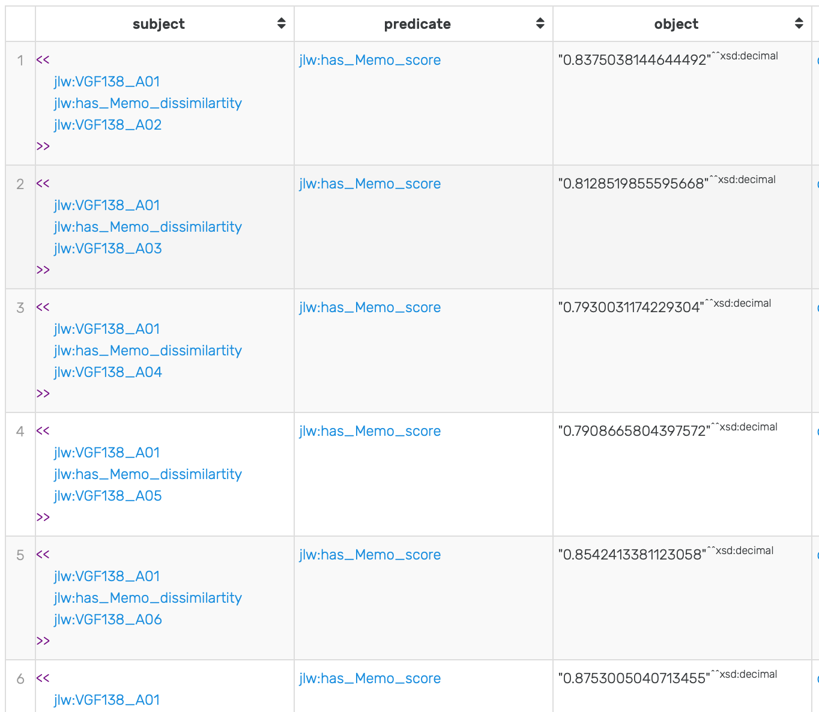
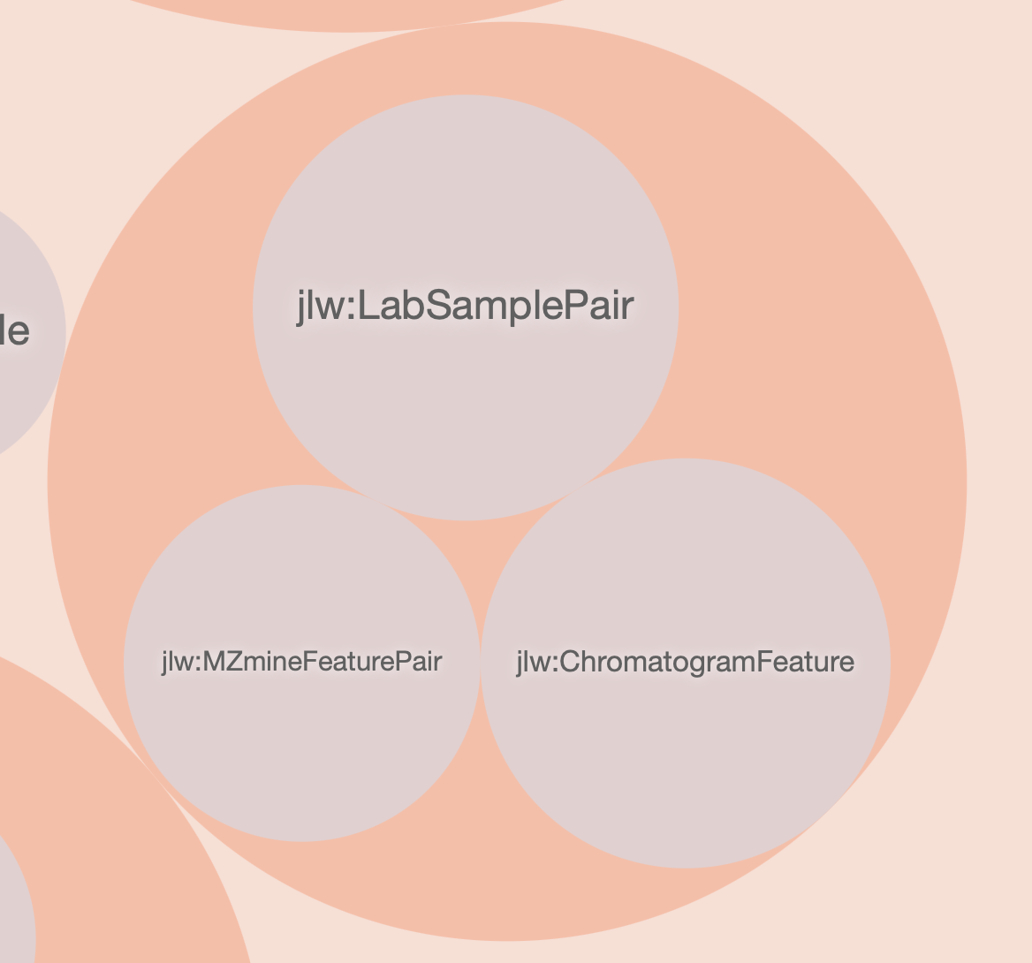
RDF-star and SPARQL-star
"Sometimes, we want the subject or object of a triple to refer to another triple. (...) is known as reification."
Well implemented on the server side of GraphDB
Poorly supported by the GUI (nothing available visual )
Will be incorporated into SPARQL 1.2 specifications... maybe?
Use case: distance matrix

Slide 33
Useful links
https://www.w3.org/TR/2014/NOTE-rdf11-primer-20140624/
https://www.ifi.uzh.ch/dam/jcr:ffffffff-8c04-b998-ffff-ffffd3a311cc/03_RDF_Schema.pdf explanation about RDF schema with a comparison to OOP

Slide 34
Data organization in RDF
Extensive data collection on the disk (git/dvc)
Filtering out unnecessary/duplicated/outdated data
Data representation tradeoff:
Not too many nodes, not too many predicates: avoid creating a monster
Find the right balance in information capture: oversimplifcation versus too much useless details
Evolvable schema for the follow-up of the project:
Motivation for chosing RDF
Reccursive trial and error stategy!

Slide 35
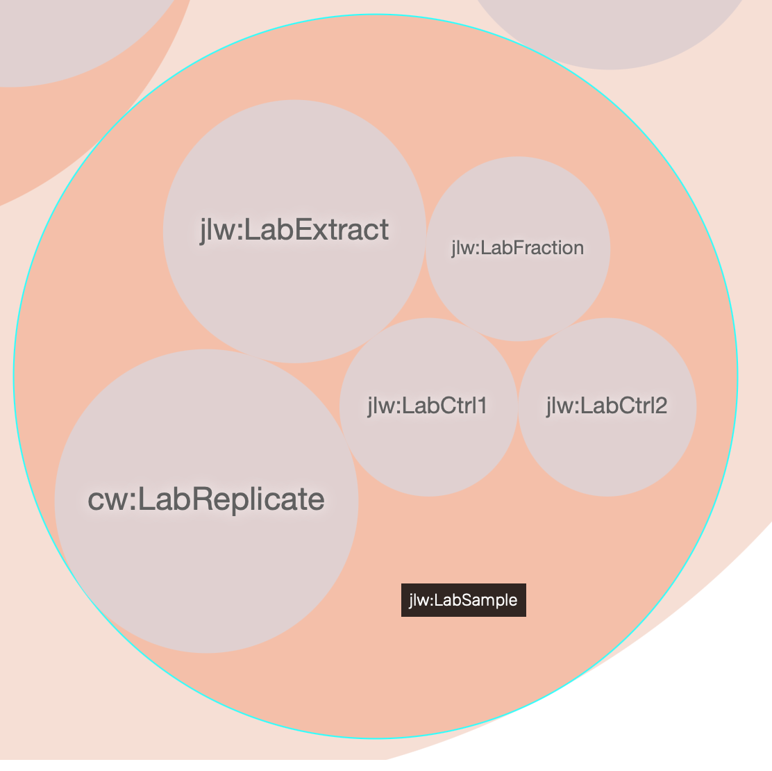
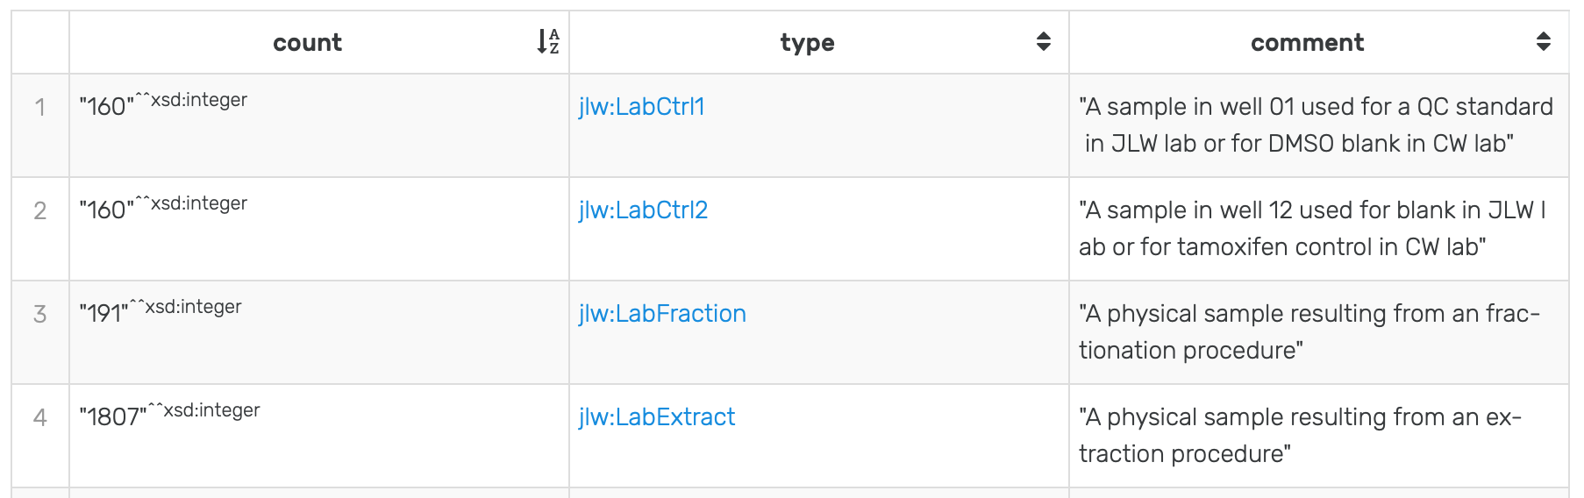
jlw:LabSample
Quality controls and blanks are important!

Slide 36
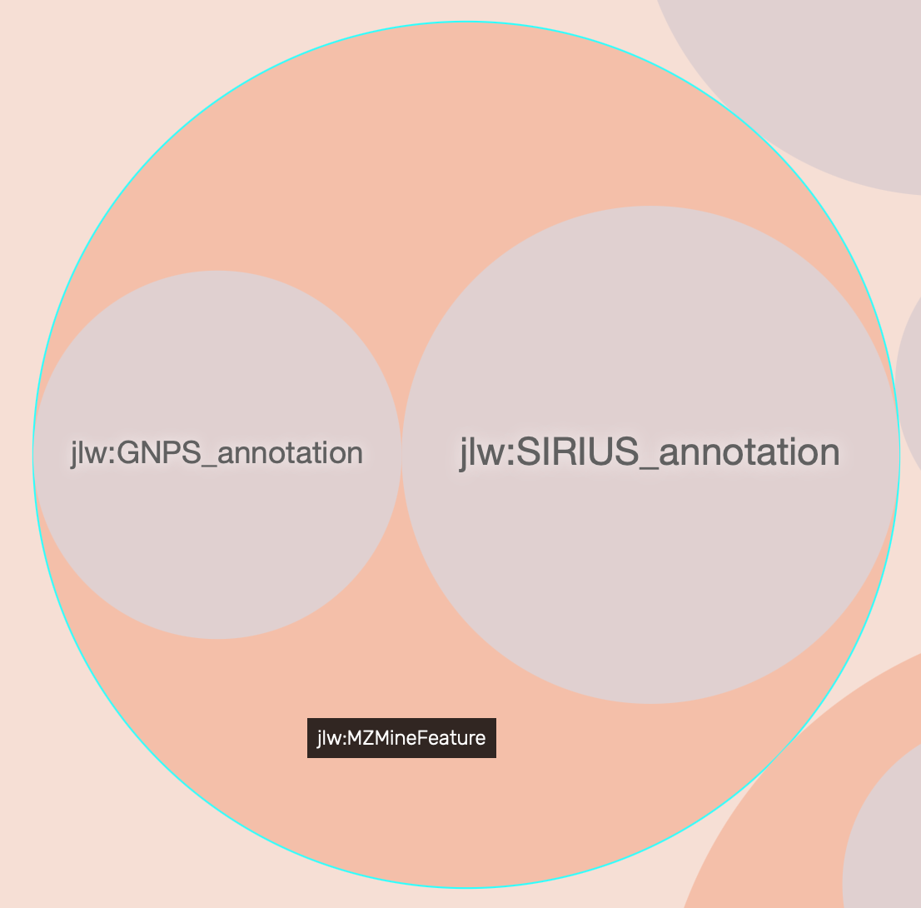
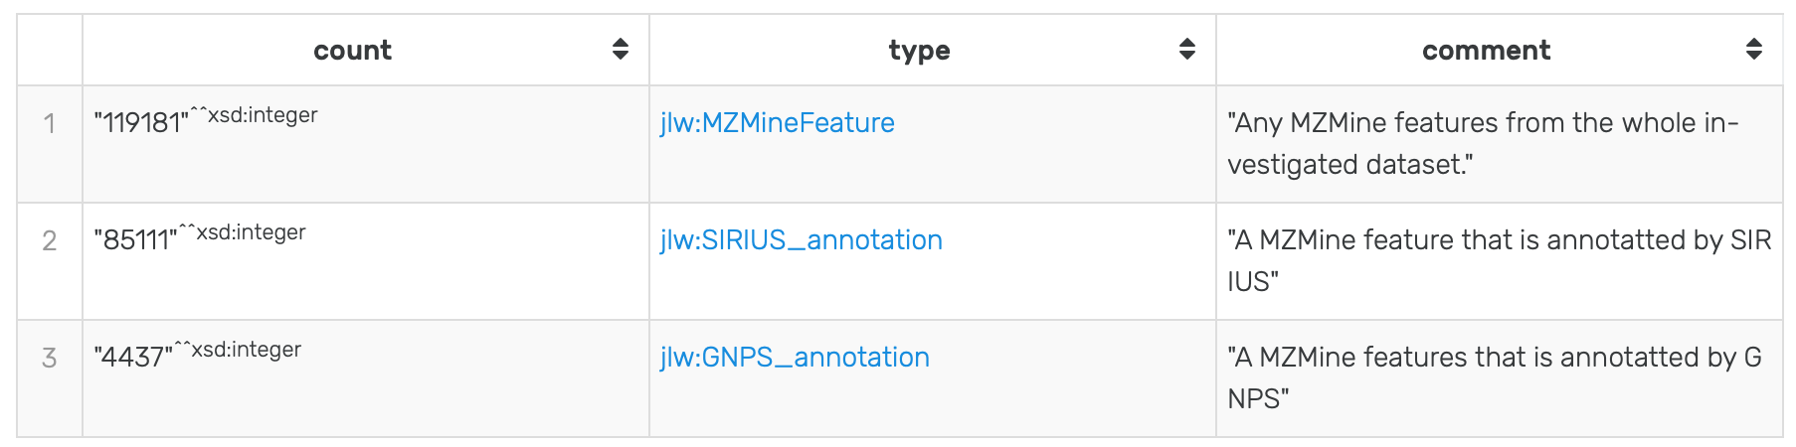
jlw:MZMineFeature
Nota Bene: Most features with GNPS annotations also have SIRIUS annotations.

Slide 37
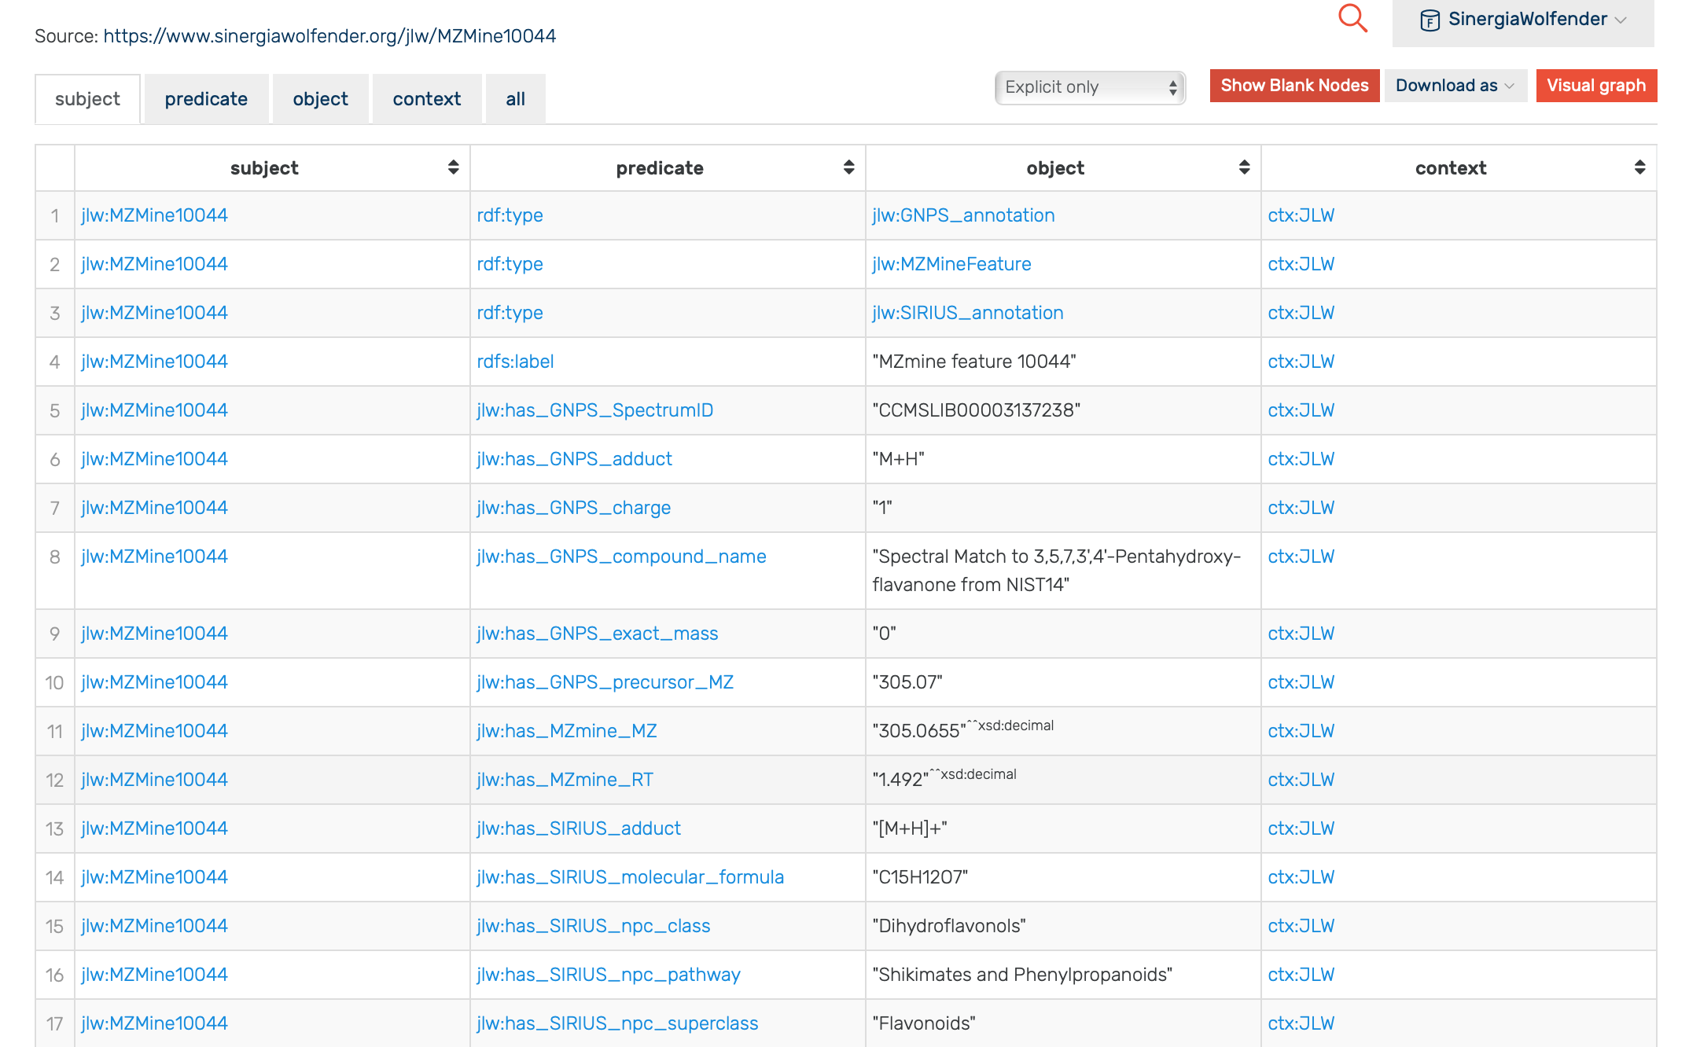

Slide 38
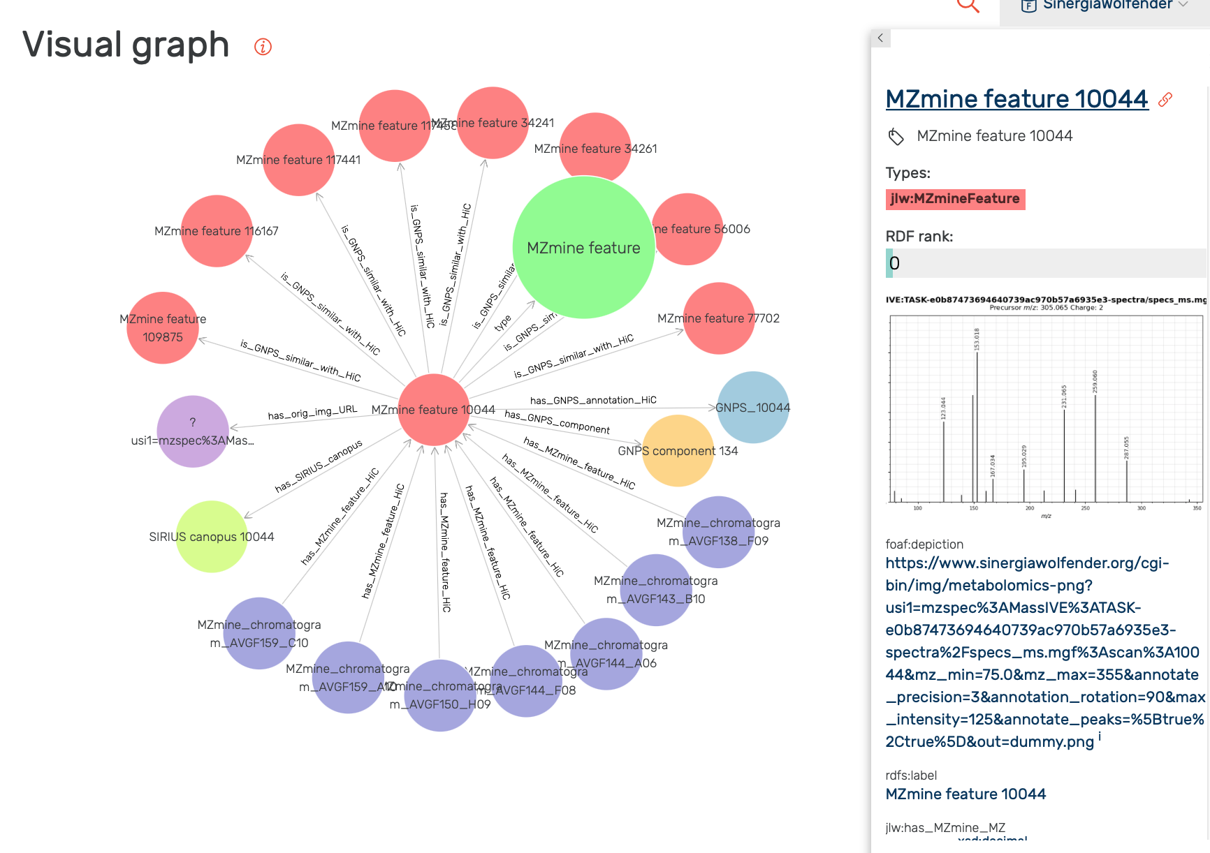
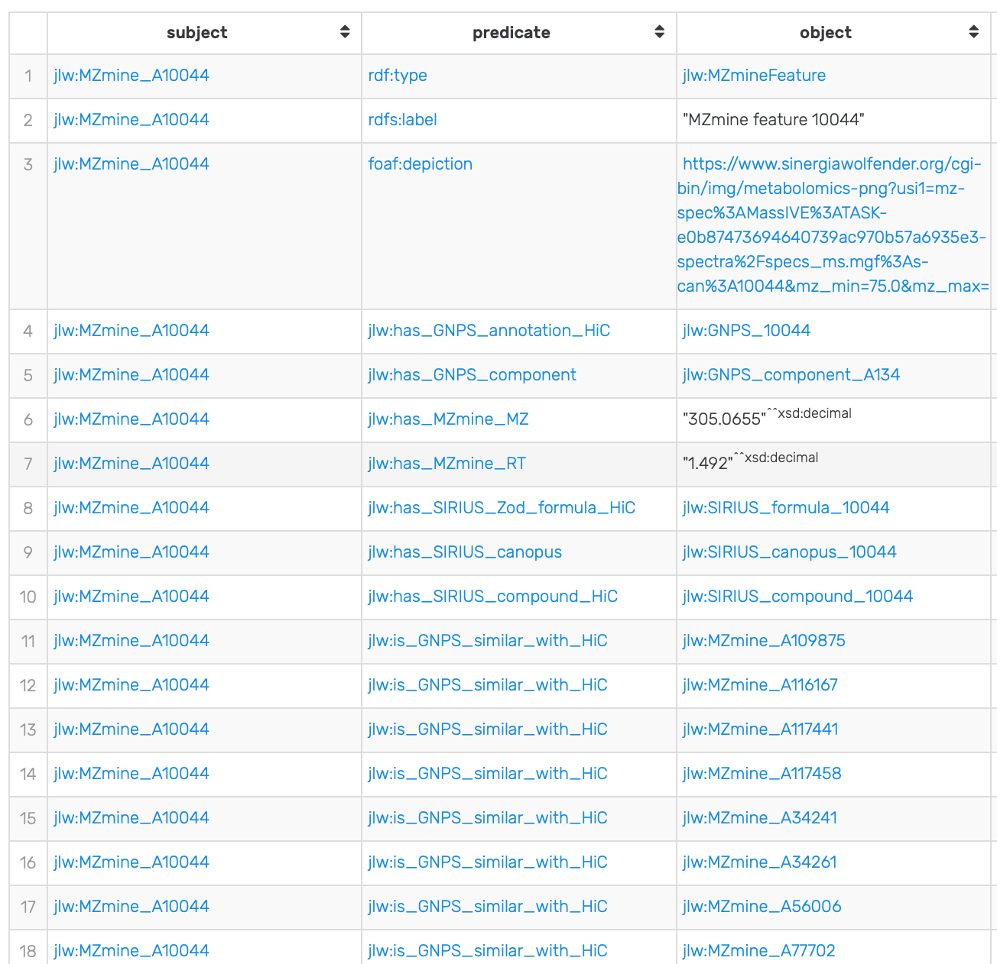

Slide 39
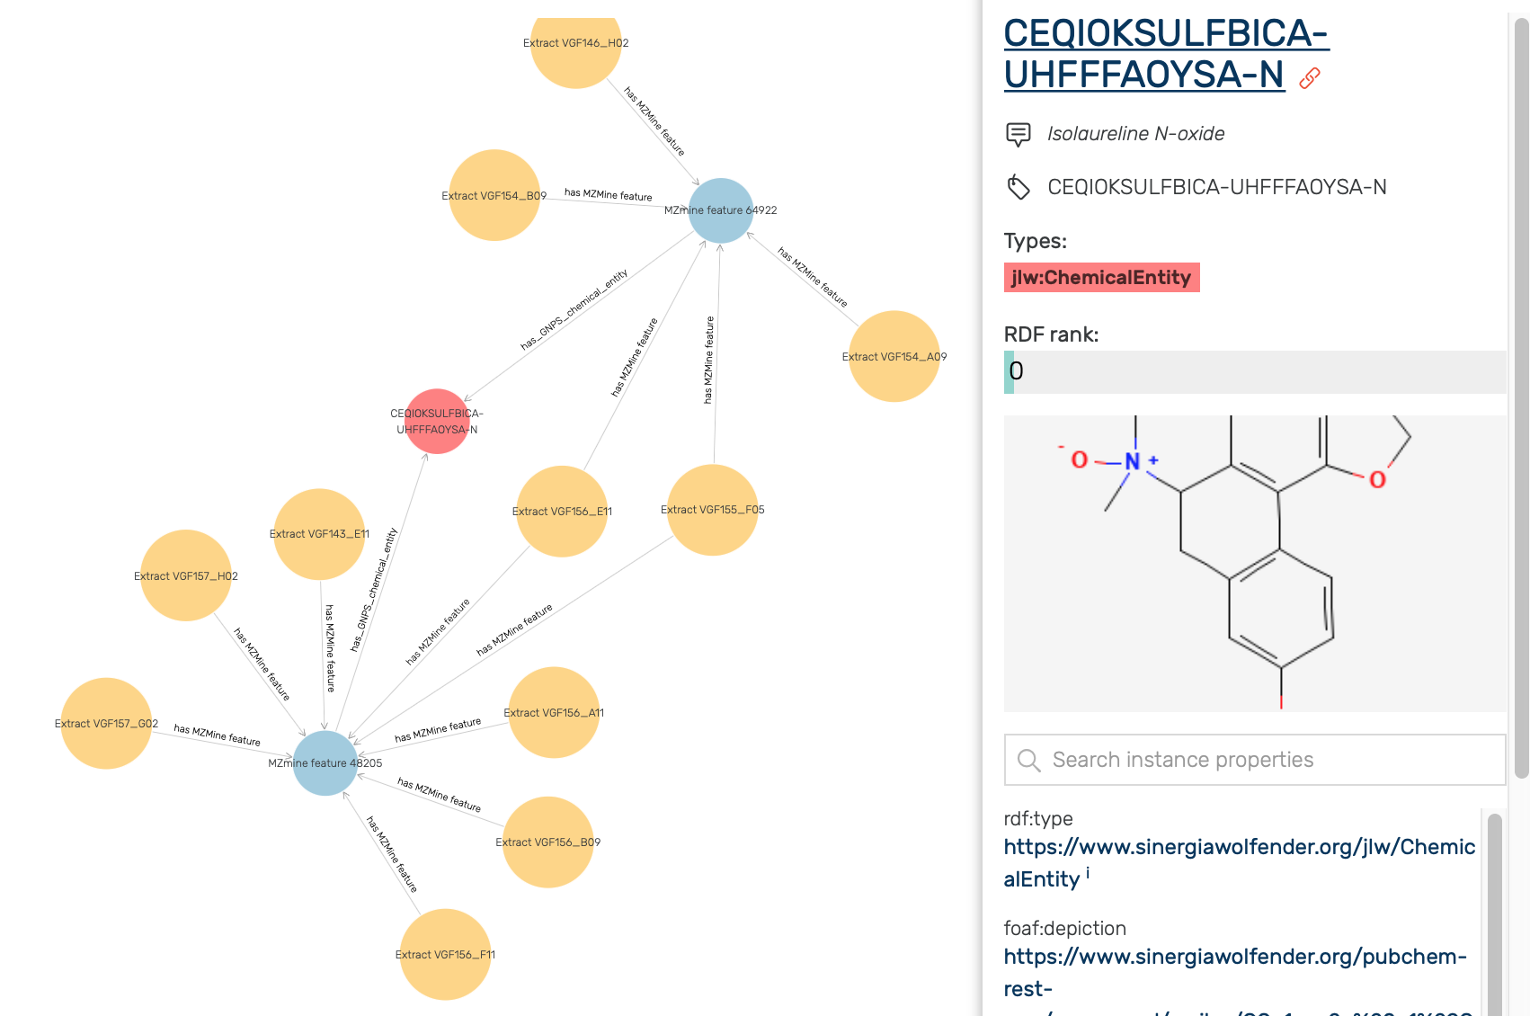
Nota bene: the molecule image is created on the fly

Slide 40
Live demo

Slide 41
Preparing and documenting the data

Slide 42
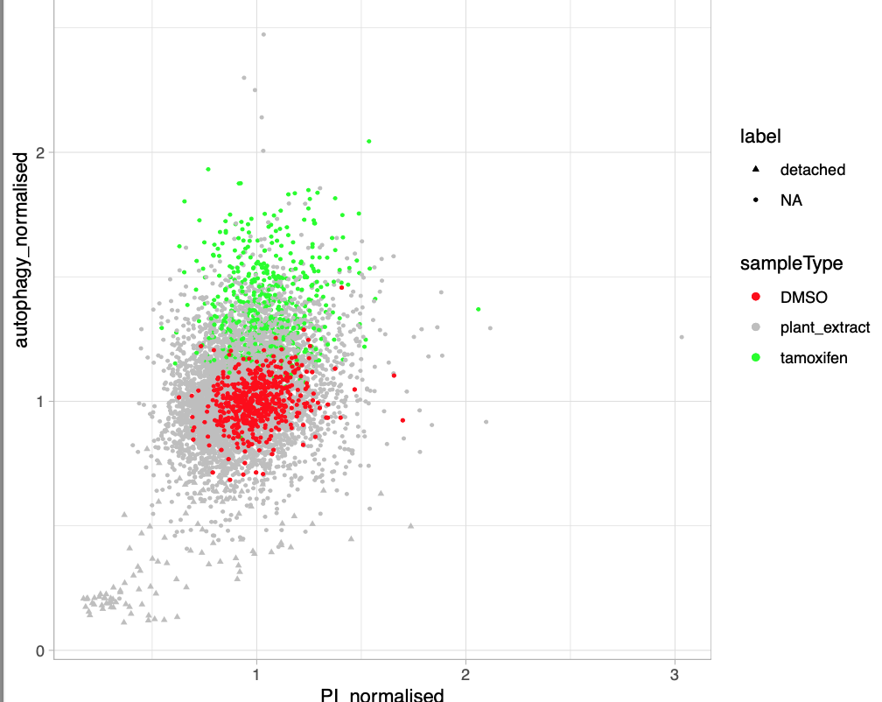
Building the RDF database
Building the resource using git/dvc
Using GraphDB as user frontend (for the time being)
Proof of concept with PMA
Ongoing consolidation of the resource with LFX, AR, AG, CW, FM, SM
A great opportunity for doing quality control... which is taking more time than expected, as many small problems are detected, and fixed!
Documentation of the dataset
About 10 mio RDF triples, currently

Slide 43
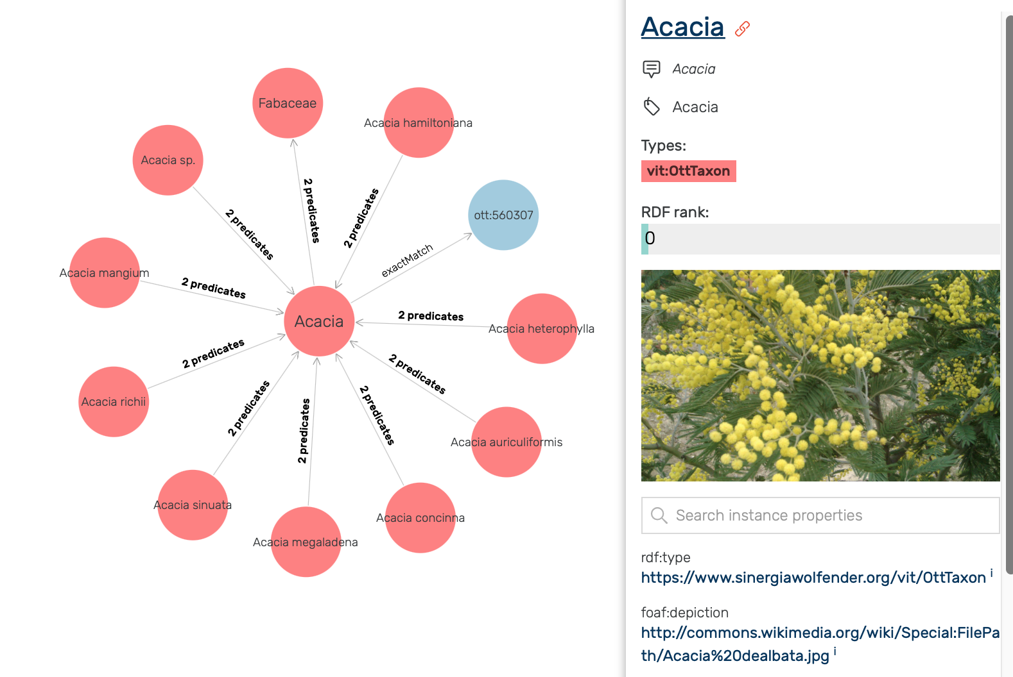
Plant Taxa
Mapping from PF-code to Open Tree of Life:
Initially made by Pierre-Marie and Adriano Rutz
OTT 3.3 chosen as reference
Solved difficulties: the same scientifc name may be given to a plant and an animal, e.g. Eclipta prostrata is both an Asteraceae and an insect
The last mapping difficulties were fixed manually by Louis-Félix Nothias
Images were imported from wikidata through its RDF service that refer OTT

Slide 44
Open Tree of Life as taxonomy
Too many nodes (i.e. > 5 mio):
Extract the small tree that document all 15'500 PFcodes: ~ 10'000 nodes
Select eight taxonomic ranks: species, genus, family, order, class, phylum, domain, life.
The tree is unbalanced:
Select eight taxonomic ranks: species, genus, family, order, class, phylum, domain, life.
Enforce every PF-code assignment to be at the species rank:
create a few "genus sp." species node as placeholder
map infra-species assignement (e.g. cultivar) to the parent species
keep track of the exact versus approximate mappings using SKOS

Slide 45
A lot more data in the pipelines
Multiple spectral "distances" between samples
CSCS methods
Memo dissimilarties
More ontologies:
NP-classification ontology (requested by LFX, in preparation)
Biological activities:
Quality control of CW lab data (ongoing)
From TS lab
From public resources
Addressing the reification challenge with RDF*

Slide 46
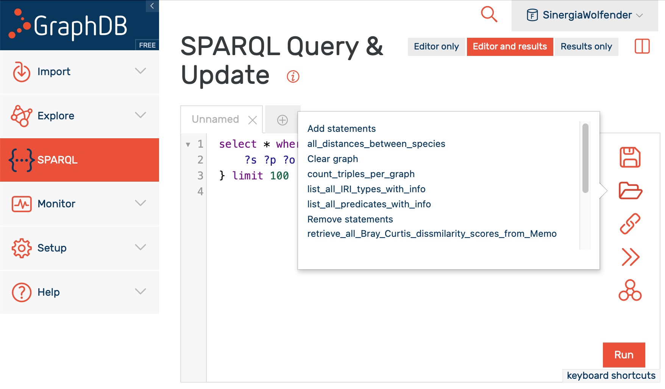
Preloaded SPARQL queries

Slide 47
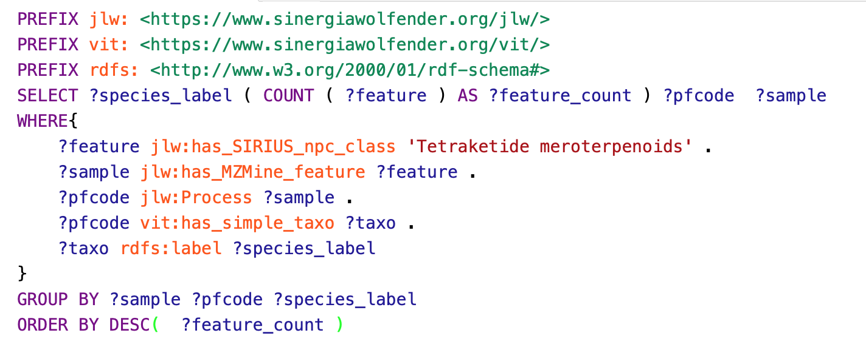
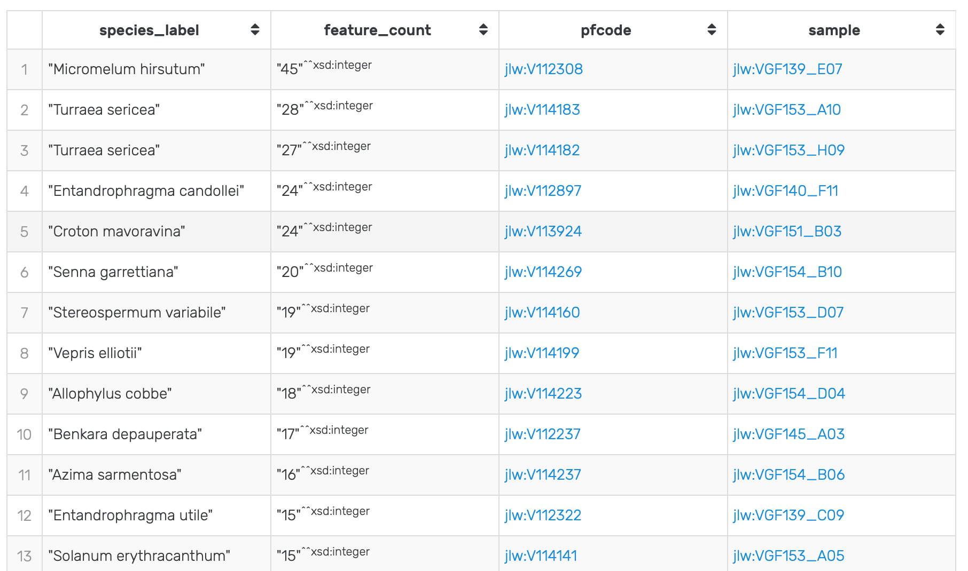

Slide 48
A private web site
We want to deploy and maintain a read-only/user-friendly version of the dataset on the server together with static pages summarizing data analyses
We bought the www.sinergiawolfender.org domain name
We deployed a virtual machine to host a web server at Vital-IT and a "read-only" instance of GraphDB
The access will be restricted:
login: sinwolf
password: sinwolf6789
available soon

Slide 49
Tutorial on the 5th of April

Slide 50
and now... Florence Mehl as a special guest

Slide 51
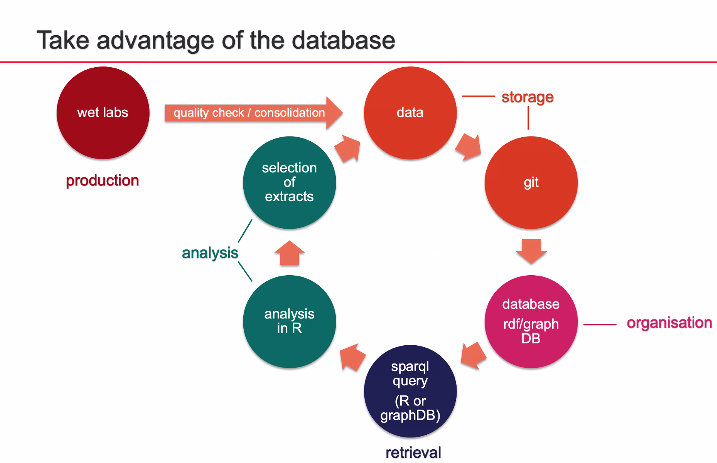
Next steps
Vital-It could organize a one-day training workshop about GraphDB/SPARQL on the website... and about how to hack them further.
Starting with a very gentle introduction with colourful graphics (and molecule images) and plenty of clickable links...
... to hard-core SPARQL queries

Slide 52
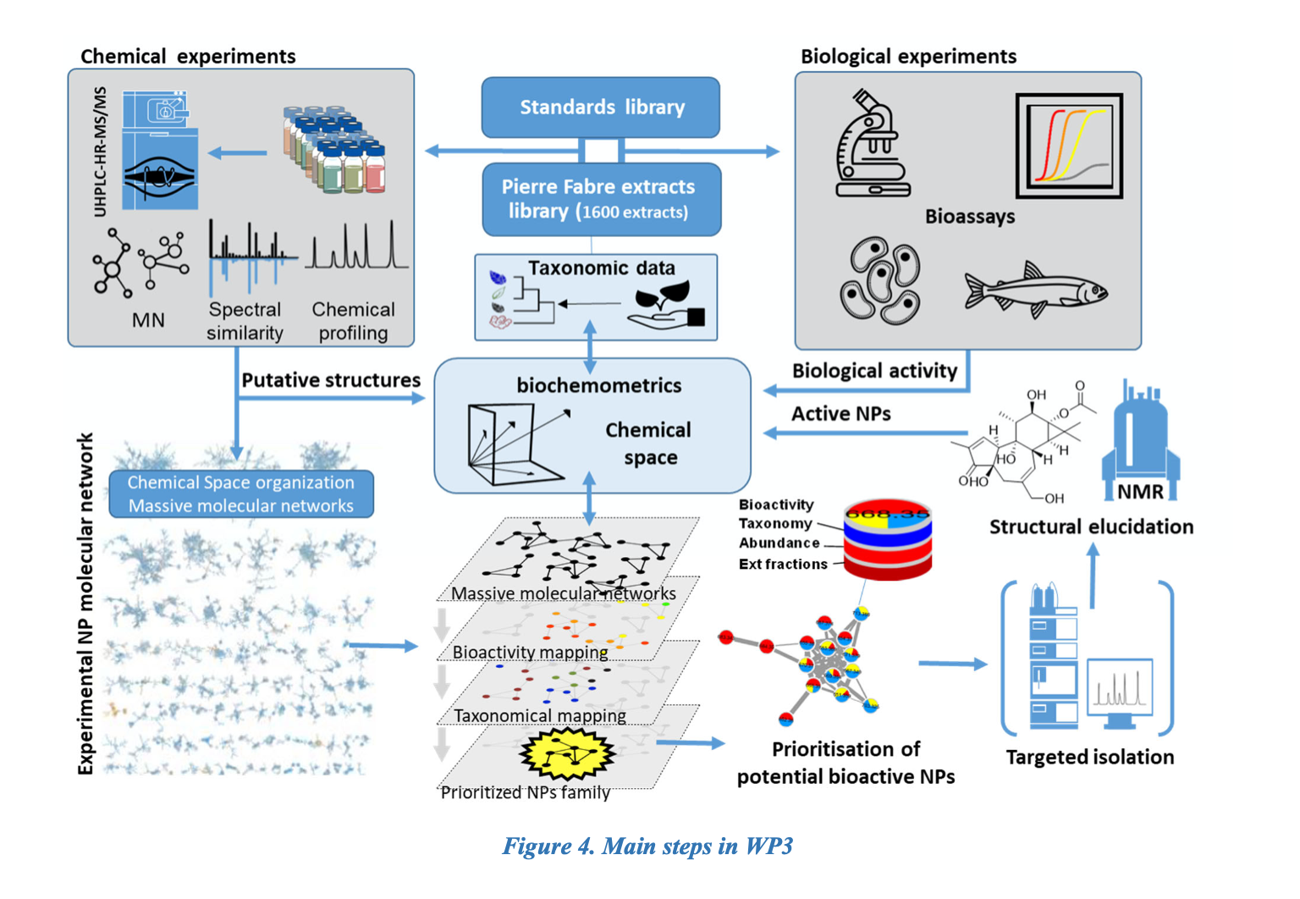
Whos' who in the project
Jean-Luc Wolfender lab
Pierre-Marie Allard (coordination, GraphDB prototype) *
Louis-Félix Nothias (coordination, MS spectra annotations) *
Adriano Rutz (taxonomy) *
Arnaud Gaudry (MEMO) *
Olivier Kirchhoffer (fractions/extractions) *
Luis Quiros Guerrero (INVENTA) *
Emerson Ferreira Queiroz
Christian Wolfrum lab
Wu Chunyan (cellular culture data)*
Erick Carreira lab
Glatz Fabian (chemical synthesis)
Thierry Soldati lab
Nabil Hanna (coordination)*
Jahn Nitschke (TB model bioassays)*
Pierre-Fabre lab
Bruno David (phytothèque) *
Antonio Grondin (phytothèque) *
Vital-IT
Marco Pagni (glue) *
Florence Mehl (coordination, quality
control, analysis) *
Robin Engler (IT support) *
Sébastien Moretti (IT support) *
Danio rerio facility
Richard Fish
*: who have directly or indirectly contributed to the content of the current RDF graph (non-exhaustive list)

Slide 53
The problems with visual graphs
Does not scale well (not GraphDB specific)
Graph layout
showing a limitted number of edges
node or URL?
A dedicated web applications may solve some of the issues, but not all
Quite a lot of work,

Slide 54
Visual Graph construct
The SPARQL CONSTRUCT query return a graph which may contain nodes and dedges that are not in the RDF graphs

Slide 55
A SPARQL tutorial (step by step)
https://docs.stardog.com/tutorials/learn-sparql
Stadog is a concurrent of GraphDB which offer a nice tutorial
The data for this tutorial have been preloaded in GraphDB in the “Tutorial” repository

Slide 56
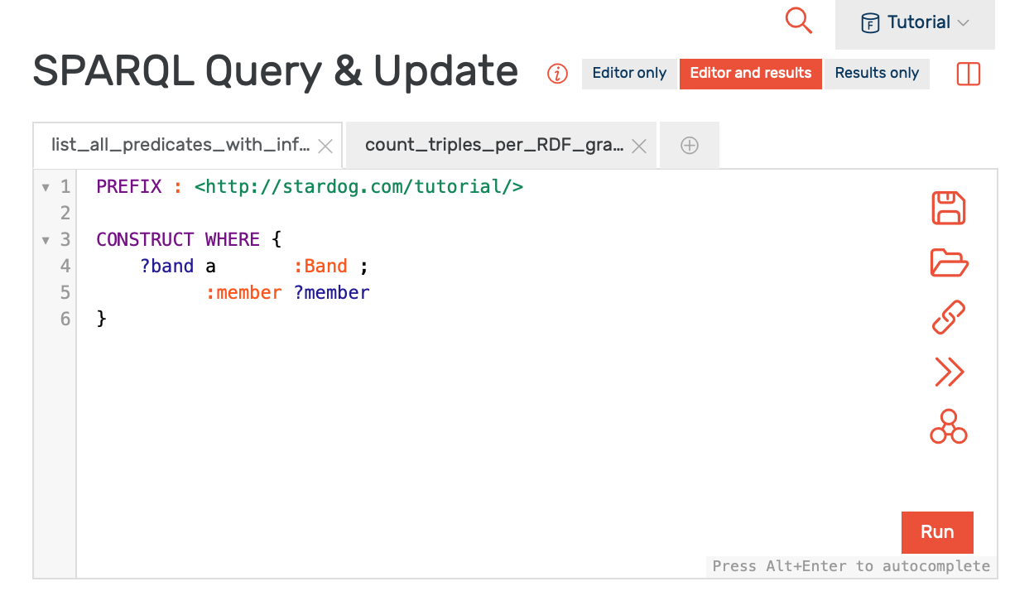
Most queries queries from the tutorial can be executed in GraphDB…
… AFTER adding the following prefix definition at the beginning of the query:
PREFIX : <http://stardog.com/tutorial/>
here

Slide 57
Quadruple and reification
Distance matrix, i.e.
Memo(sample1, Sample2) = score
Entries of a distance matrix cannot be stored in a triple this is a quarduple:
Name of the distance/matrix
Sample1
Sample2
score
=> solutions:
Blank node
Reification
RDF-star

Slide 58
Nota Bene:
Most queries should work nicely in GraphDB
The syntax paths … via is a stardog extension will not work. It is a stardog extension, that also exist in GraphDB under a different syntax
Queries with INSERT and/or DELETE cannot work in a read-only repository

Slide 59
RDF-star / SPARQL-star
A triple noted between "<<" and ">>" brackets can act as subject or obkject in another tripple.
Visible in GraphDB tables, but not in graphics
Proposed for SPARQL 1.2 specifications
<< jlw:VGF151_D01 vit:in_pair_with jlw:VGF151_D02 >>
a jlw:LabSamplePair ;
jlw:has_Memo_score 0.7904882789258657 .

Slide 60
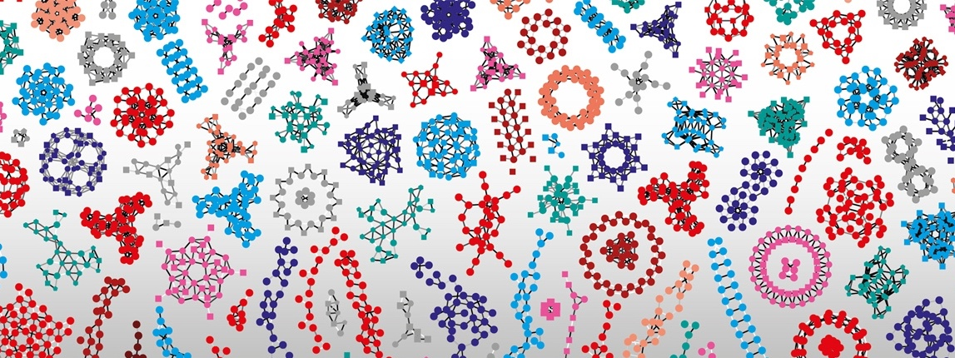
Thank you

